Slide 1
Entity Relationship Diagram 2/3
School of Computing and Engineering

Slide 2
Learning Objectives
Explain the rules and style guidelines for creating ERD
Identify ERD elements
Describe ERD
Create an ERD
Define Data Dictionary

Slide 3
Lecture Plan
Recap from the last lecture 5min
Entity Relationship Diagram 35min
Class Exercise 15min

Slide 4
Recap from the previous lecture
What is an entity and their attributes?
Identify entities and their relationships for the given scenario.

Slide 5
Entity and Attributes
Entity: a person, place, object, event or concept in the user environment about which data is to be maintained.
The entity is the basic building block for a data model. It is a person, place, event, or thing about which data is collected. E.g. an employee, an order and a product
Attribute: a named property or characteristic of an entity that is of interest to the organization.
An attribute is some type of information that is captured about an entity.

Slide 6
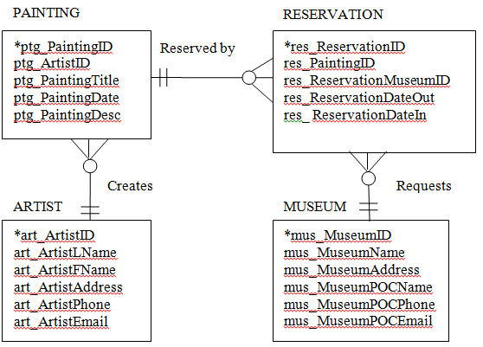
Identifier/Primary key
One or more attributes can serve as the identifier (primary key).
Identifier can uniquely identify one instance of an entity.
Attributes that serve as the identifier are noted by an asterisk next to the attribute name.
ptg_PaintingID is an identifier for Painting
res_ReservationID is an identifer for Reservation
Notes:
Choosing the right identifier:If there are no customers with the same last name, then last name can be used as the identifier of the customer entity. In this case, if we need to locate John Brown, the name Brown would be sufficient to identify the one instance of the Brown last name. Suppose that we add a customer named Sarah Brown. Now we have a problem: Using the name Brown would not uniquely lead to one instance. It would lead to two (i.e., John Brown and Sarah Brown). You have three choices at this point, and all are acceptable solutions. First, you can use a combination of multiple fields to serve as the identifier (last name and first name). This is called a concatenated identifier because several fields are combined, or concatenated, to uniquely identify an instance. Second, you can find a field that is unique for each instance, like the customer ID number. Third, you can wait to assign an identifier (like a randomly generated number that the system will create).

Slide 7
Building ERD
Step 1: Identify the entities
Step 2: Add Attributes and assign identifiers
Step 3: Identify Relationships:
Relationships names
Cardinalities
Modalities

Slide 8
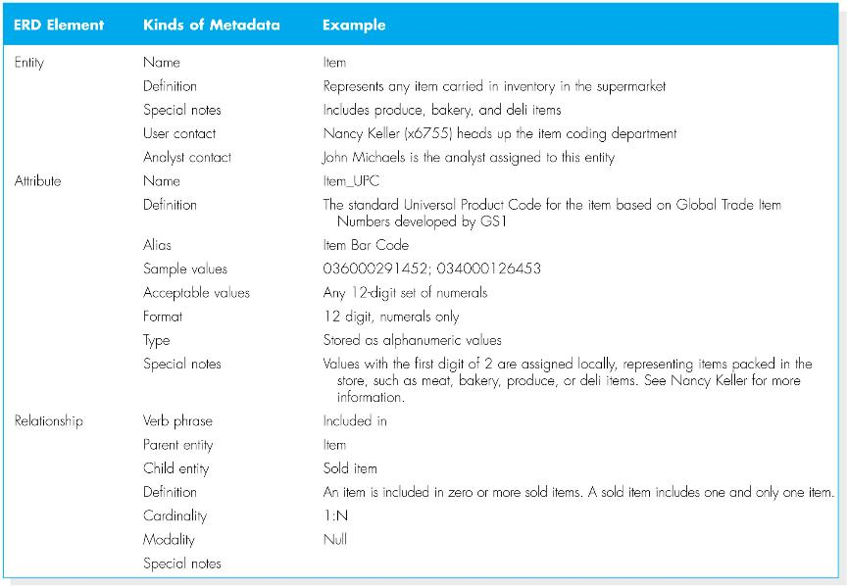

Slide 9
ERD general design guidelines
Labels and naming conventions are important for creating clear ERDs. Names should not be ambiguous:
Name and number
The name should be consistent across the model and reflect the terminology used by the business.
If people who order product are called customer in the business in the model they should be an entity called customer (not client or stakeholder).
There are no rules covering the layout of ERD components. They can be placed anywhere you like on the page. Although most systems analysts try to put the entities together that are related to each other.

Slide 10
Entity types
Independent Entity: Is an entity that can exist without the help of another entity. Attributes from other entities were not needed to uniquely identify instances of these entities. Independent entity is shown as rectangle with single border line.
Dependent Entity: There are situations when an entity does require attributes from another entity to uniquely identify an instance. This entity is called a dependent entity and its identifier consists of at least one attribute from the other entity. A dependent entity is shown as a rectangle with double border line.
Intersection Entity: Intersection entities are added to a data model to store information about two entities sharing many to many relationship in order to remove the man-to-many relationship.

Slide 11
Question
What is the purpose of developing an identifier for an entity?

Slide 12
Answer
One of the aspects of the definition of an entity is the fact that there are multiple occurrences of the entity. If there are not multiple instances of something that is a potential entity, that something is not an entity in the system. Consequently, there must be a way of identifying each individual occurrence of an entity so that it can be picked out from amongst all the other instances of the entity. That is the purpose of having identifiers with unique values.

Slide 13
Class Exercise
A publishing company produces scientific books on various subjects. The books are written by authors who specialize in one particular subject. The company employs editors who, not necessarily being specialists in a particular area, each take sole responsibility for editing one or more publications. A publication covers essentially one of the specialist subjects and is normally written by a single author. When writing a particular book, each author works with on editor, but may submit another work for publication to be supervised by other editors. To improve their competitiveness, the company tries to employ a variety of authors, more than one author being a specialist in a particular subject.

Slide 14
Tasks
Identify entities
Add your attributes and identifier for each entity.
Identify relationships.
Identify the following entitles:
Independent Entity
Dependent Entity
Intersection Entity

Slide 15
References
Dennis, A., and Wixom, B. H, “Systems Analysis and Design”, 5th Edition, John Wiley & Sons (2013), Chapter Six.
Hoffer, J. A., George, J. F., Valacich J. S., “Modern Systems Analysis and Design”, 7th Edition, Pearson Education. Chapter Eight.

